Slide 1
K Means Clustering

Slide 2
K Means Clustering Algorithm
K-Means Clustering Algorithm is a widely used unsupervised machine learning algorithm for partitioning data into K distinct non-overlapping clusters.
It minimizes the intra-cluster variance (i.e., the sum of squared distances between each point and the centroid of its cluster).

Slide 3
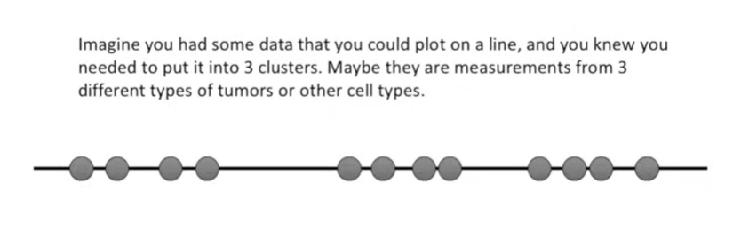

Slide 4
Key Concepts
Cluster: A group of data points that are more similar to each other than to those in other groups.
Centroid: The center (mean position) of all points in a cluster.
K: The number of clusters you want to find in your data.

Slide 5
Algorithm
Initialize: Choose K initial centroids (randomly or using some heuristic).
Assignment step: Assign each data point to the nearest centroid (using Euclidean distance by default).
Update step: Recalculate each centroid as the mean of all data points assigned to that cluster.
Repeat steps 2 and 3 until:
Centroids do not change (convergence)
Or a maximum number of iterations is reached

Slide 6
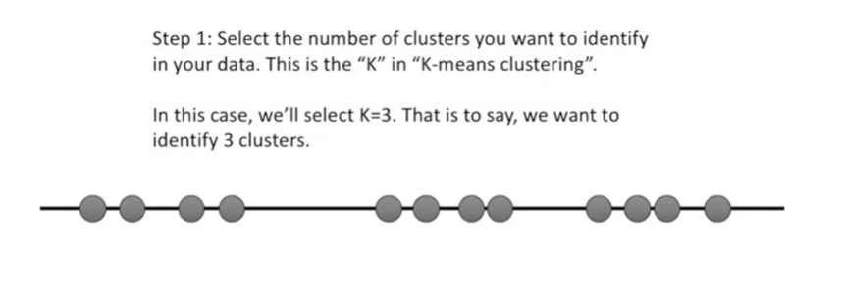

Slide 7
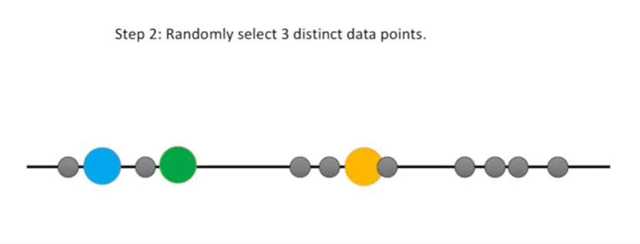

Slide 8
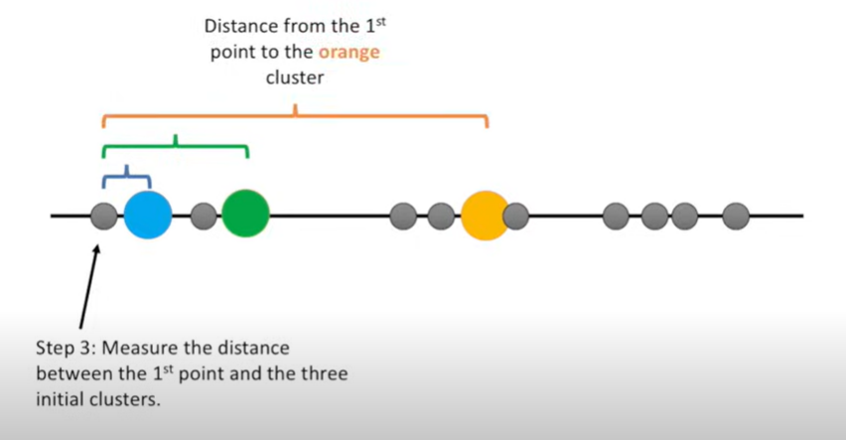

Slide 9
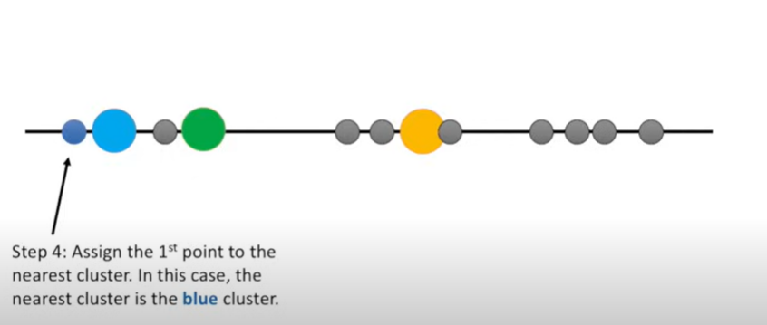

Slide 10
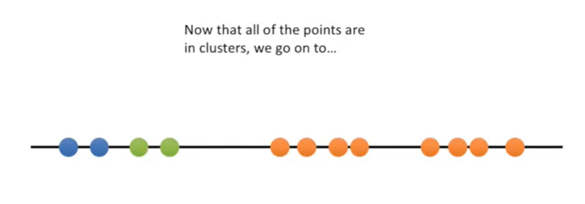

Slide 11
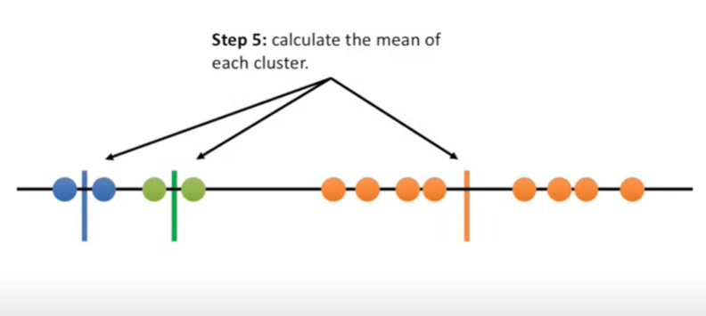

Slide 12
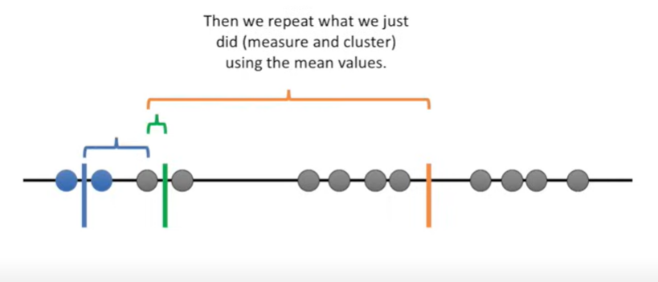

Slide 13
